Slide 1

Doubly Linked List

Slide 2

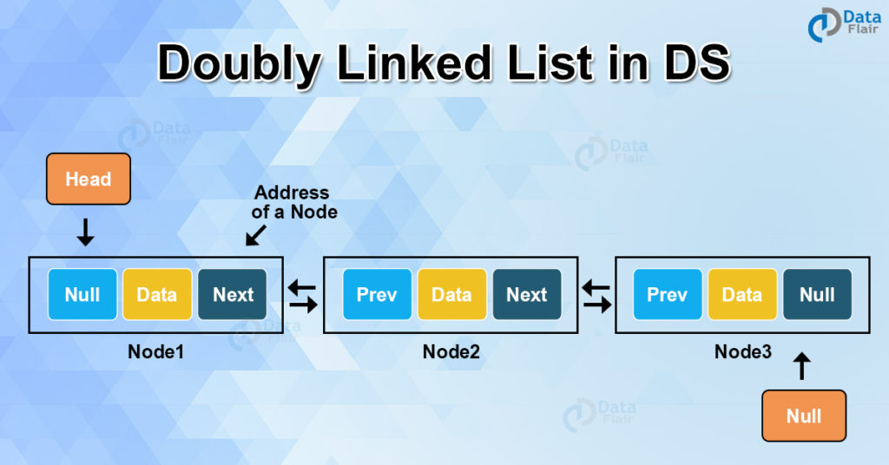
Doubly Linked List
Doubly Linked List is a variation of Linked list in which navigation is possible in both ways, either forward and backward easily

Slide 3

Doubly Linked list Representation
Doubly Linked List contains a link element called first and last.
Each link carries a data field(s) and a link field called next.
Each link is linked with its next link using its next link.
Each link is linked with its previous link using its previous link.
The last link carries a link as null to mark the end of the list.

Slide 4
Doubly Linked list Representation
DLL can be traversed in both forward and backward directions.
The delete operation in DLL is more efficient if a pointer to the node to be deleted is given.
We can quickly insert a new node before a given node.
In a singly linked list, to delete a node, a pointer to the previous node is needed. To get this previous node, sometimes the list is traversed. In DLL, we can get the previous node using the previous pointer.

Slide 5
Doubly Linked list Representation
Single node can be represented as
struct node {
int data;
struct node *next;
struct node *prev;}

Slide 6
Creation of DLL
#include <stdio.h>
#include <stdlib.h>
struct node {
int num;
struct node * preptr;
struct node * nextptr; }*stnode, *ennode;
void DlListcreation(int n);
void displayDlList();

Slide 7
Creation of DLL
int main(){ int n; stnode = NULL; ennode = NULL; printf(“ Input the number of nodes : “); scanf(“%d”, &n); DlListcreation(n); displayDlList(); return 0; }

Slide 8
Creation of DLL
Void DlListcreation(int n){ int i, num; struct node *fnNode; if(n >= 1) { stnode = (struct node *)malloc(sizeof(struct node)); if(stnode != NULL) { printf(“ Input data for node 1 : “); // assigning data in the first node scanf(“%d”, &num); stnode->num = num; stnode->preptr = NULL; stnode->nextptr = NULL; ennode = stnode;

Slide 9
Creation of DLL
for(i=2; i<=n; i++) { fnNode = (struct node *)malloc(sizeof(struct node)); if(fnNode != NULL) { printf(“ Input data for node %d : “, i); scanf(“%d”, &num); fnNode->num = num; fnNode->preptr = ennode; // new node is linking with the previous node fnNode->nextptr = NULL; ennode->nextptr = fnNode; // previous node is linking with the new node ennode = fnNode; // assign new node as last node } else { printf(“ Memory can not be allocated.”); break; }} } else { printf(“ Memory can not be allocated.”); } }}

Slide 10
Creation of DLL
Void displayDlList(){ struct node * tmp; int n = 1; if(stnode == NULL) { printf(“ No data found in the List yet.”); } else { tmp = stnode; printf(“\n\n Data entered on the list are :\n”); while(tmp != NULL) { printf(“ node %d : %d\n”, n, tmp->num); n++; tmp = tmp->nextptr; // current pointer moves to the next node } }}

Slide 11
Insertion
At the beginning
There are two scenarios of inserting any element into doubly linked list. Either the list is empty or it contains at least one element
Allocate the space for the new node in the memory.
Check whether the list is empty or not. The list is empty if the condition head == NULL holds. In that case, the node will be inserted as the only node of the list and therefore the prev and the next pointer of the node will point to NULL and the head pointer will point to this node.
In the second scenario, the condition head == NULL become false and the node will be inserted in beginning. The next pointer of the node will point to the existing head pointer of the node. The prev pointer of the existing head will point to the new node being inserted.
Since, the node being inserted is the first node of the list and therefore it must contain NULL in its prev pointer. Hence assign null to its previous part and make the head point to this node.

Slide 12
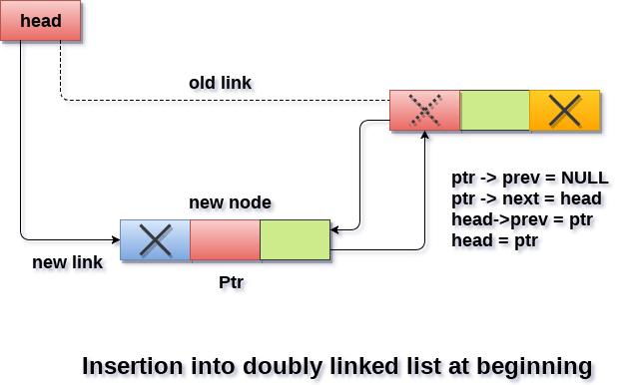
InsertionAt the beginning

Slide 13
InsertionAt the beginning
Start Declare a structure variable pointer , ptr
Allocate memory to ptr
If ptr==Null, go to step5 else go to step6
Print memory allocation is not successful
If head==Null, go to step 7 else go to step11 Set ptr->next = NULL; Set ptr->prev=NULL; Set ptr->data=item; Set head=ptr, go to step 16
Set ptr->data=item; ptr->prev=NULL; ptr->next = head; //200 head->prev=ptr; //100 head=ptr; //10016) stop

Slide 14
InsertionAt the beginning
void insertbeginning(int item) {
struct node *ptr = (struct node *)malloc(sizeof(struct node));
if(ptr == NULL) {
printf(“memory allocation not successful “);
else
{ if(head==NULL) { ptr->next = NULL; ptr->prev=NULL; ptr->data=item; head=ptr; } else { ptr->data=item; ptr->prev=NULL; ptr->next = head; head->prev=ptr; head=ptr; } } }

Slide 15
Insertion at end
Start Declare a structure variable pointer , ptr
Allocate memory to ptr
If ptr==Null, go to step5 else go to step6
Print memory allocation is not successful
If head==Null, go to step 7 else go to step11 Set ptr->next = NULL; Set ptr->prev=NULL; Set ptr->data=item; Set head=ptr, go to step 16

Slide 16
Insertion at end
11) Set temp=head
12) Check whether temp->next! =null, repeat step 13 else go to step14
13) temp=temp->next
14) Set temp->next = ptr; 15) Set ptr ->prev=temp; 16) Set ptr->next = NULL;

Slide 17
Insertion at end
Else { temp = head; while(temp->next!=NULL) { temp = temp->next; } temp->next = ptr; ptr ->prev=temp; ptr->next = NULL; } } printf(“\nnode inserted\n”); }

Slide 18
Insertion at end
Void insertion_last() { struct node *ptr,*temp; int item; ptr = (struct node *) malloc(sizeof(struct node)); if(ptr == NULL) { printf(“\nOVERFLOW”); }
else {
printf("\nEnter value");
scanf("%d",&item);
ptr->data=item;
if(head == NULL) {
ptr->next = NULL;
ptr->prev = NULL;
head = ptr; }

Slide 19
Deletion

Slide 20
Deletion at beginning
Deletion at first
1) Start
2)Declare a structure pointer temp
3)Check if head==null, then go to step4 else go to step5
4)Print linked list empty
5)Assign temp as head
6)Return temp->data
7)Assign head as temp->next, head->prev=null
8)Delete temp
9)Stop

Slide 21
Deletion at beginning
Void deletefirst() {
struct node *temp;
If(head==Null) {
printf (“linked list empty “) ;}
else{
temp=head;
printf (“deleted item is”) ;
printf (“%d”, temp->data) ;
head=temp->next;
head->prev=null;
free(temp)
} }

Slide 22
Deletion at beginning
Algorithm to delete the first node** Step 1: IF head = NULL Print No elements in list Go to Step 6 [END OF IF] Step 2: SET ptr = head, return head->data Step 3: SET head= head -> next Step 4: SET head -> prev= NULL Step 5: FREE ptr Step 6: EXIT

Slide 23
Deletion at beginning
Void deletionatbegning() {
Struct node *ptr; ptr = head;
printf (“deleted item is”, head->data) ; head = head -> next; head -> prev = NULL; free(ptr); ;}

Slide 24
Deletion at end
Deletion at end
1) Start
2)Declare a structure pointer temp and back
3) Check if (head=null) then go to step4 else go to step5
4) Print linked list empty, go to step 16
5) Initialize temp as head
6) Check if temp->next = null, then do step 7-9 else go to step 10
7) Return temp->data
8) Delete temp
9) Set head=Null
10) Check if temp->next! =null , then repeat step 11-12 else go to step13
11) Assign back as temp
12) Set temp=temp->next

Slide 25
Deletion at end
13) Return temp->data 14) Delete temp 15) Set back->next=null 16) Stop

Slide 26
Deletion at end
Void deleteend() {
struct node *temp, *back;
If (head=null) {
Print(“linked list empty”) ;}
Else{
temp=head;
If(temp->next==Null) {
Printf(“deleted element is %d”, temp->data) ;
free(temp) ;
Head=NULL}

Slide 27
Deletion at end
While(temp->next! =NULL) {
back=temp;
temp=temp->next;}
printf(“deleted element is%d”, temp->data) ;
free(temp) ;
back->next=NULL;}
}

Slide 28
Deletion at End
Algorithm to delete the last node**
Step 1: IF START = NULL
Write UNDERFLOW
Go to Step 7
[END OF IF]
Step 2: SET PTR = START
Step 3: Repeat Step 4 while PTR -> NEXT != NULL
Step 4: SET PTR = PTR -> NEXT
[END OF LOOP]
Step 5: SET PTR -> PREV -> NEXT = NULL
Step 6: FREE PTR
Step 7: EXIT

Slide 29
Deletion at End
Void deletionatend()
Struct node *ptr; ptr = head; while(ptr -> next != NULL) ptr = ptr -> next; ptr -> prev -> next = NULL; free(ptr); return start;

